Slide 1
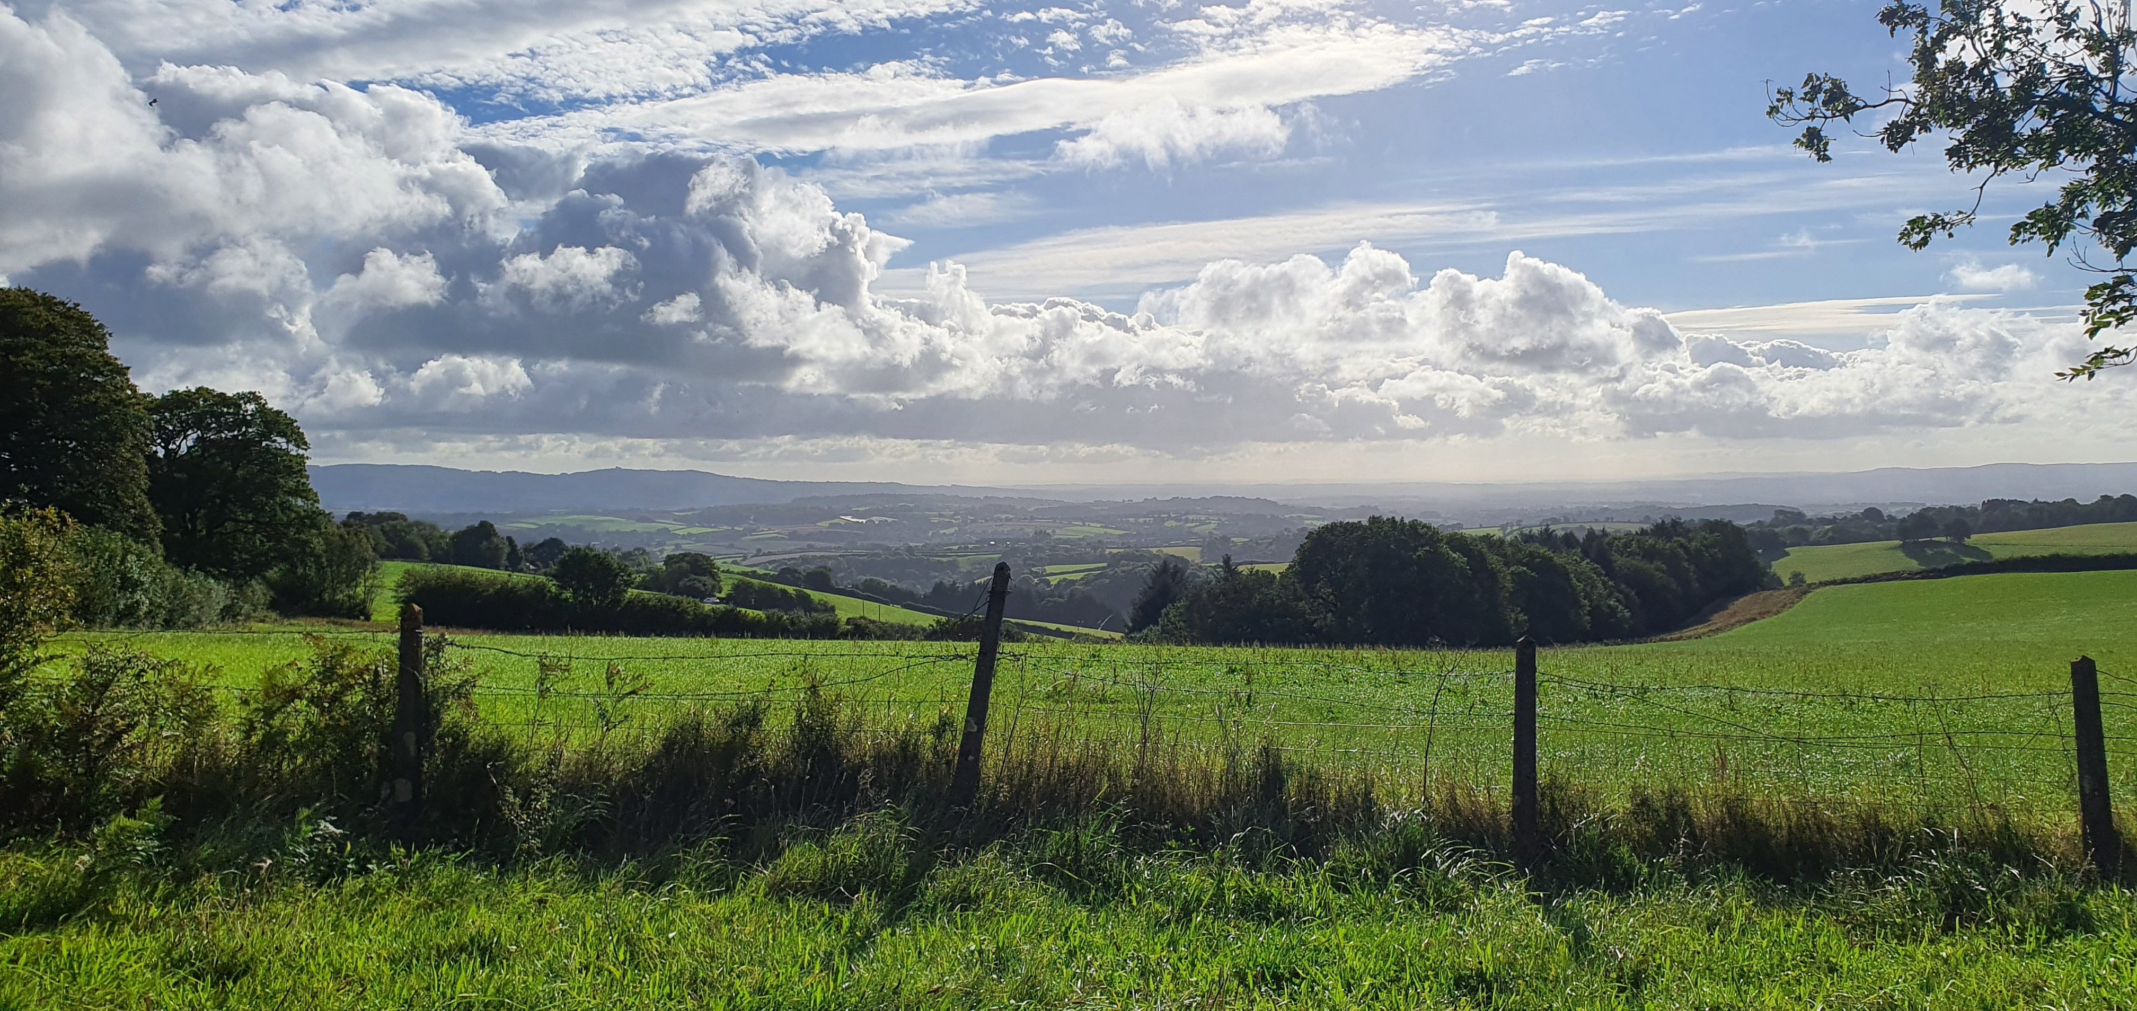

Slide 2

Jupyter Notebooks For DBAs
Rob Sewell
@SQLDbaWithBeard
blog.robsewell.com

Slide 3
Rob Sewell
Consultant
Data Platform and Cloud and DataCenter Management MVP
@SQLDbaWithBeard
beard.media/book – 40 % code twitsewe40
Blog.robsewell.com

Slide 4
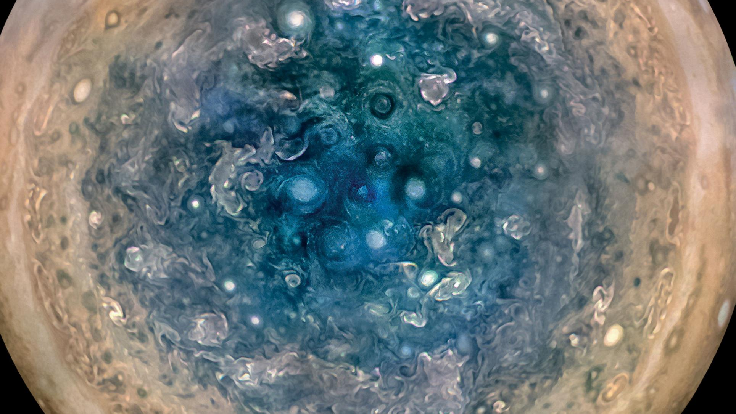

Slide 5
First, the names comes from the planet Jupiter. We wanted to pick a name that evoked the traditions and ideas of science.
Jupyter

Slide 6
Jupyter
Second, the core programming languages supported by Jupyter are
Julia, Python and R.
While the name Jupyter is not a direct acronym for these languages, it nods its head in those directions.
In particular, the "y" in the middle of Jupyter was chosen to honor our Python heritage.
First, the names comes from the planet Jupiter. We wanted to pick a name that evoked the traditions and ideas of science.
https://github.com/jupyter/design/wiki/Jupyter-Logo

Slide 7
Jupyter
Second, the core programming languages supported by Jupyter are
Julia, Python and R.
While the name Jupyter is not a direct acronym for these languages, it nods its head in those directions.
In particular, the "y" in the middle of Jupyter was chosen to honor our Python heritage.
Third, Galileo was the first person to discover the moons of Jupiter. His publication on the moons of Jupiter is an early example of research that includes the underlying data in the publication. This is one of the core ideas and requirements for scientific reproducibility. Reproducibility is one of the main focuses of our project.
https://github.com/jupyter/design/wiki/Jupyter-Logo

Slide 8
Jupyter
Third, Galileo was the first person to discover the moons of Jupiter. His publication on the moons of Jupiter is an early example of research that includes the underlying data in the publication. This is one of the core ideas and requirements for scientific reproducibility. Reproducibility is one of the main focuses of our project.
https://github.com/jupyter/design/wiki/Jupyter-Logo

Slide 9
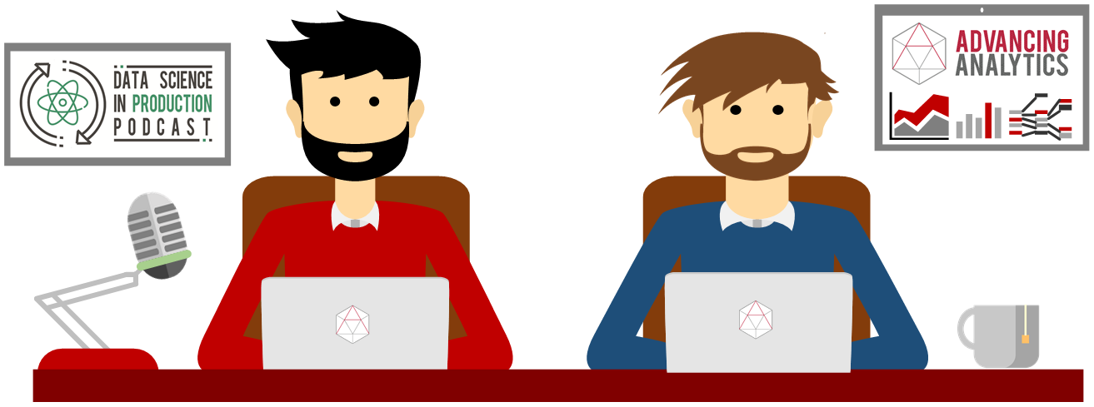
What is a Jupyter Notebook?
Originally for Data Scientists

Slide 10


Slide 11
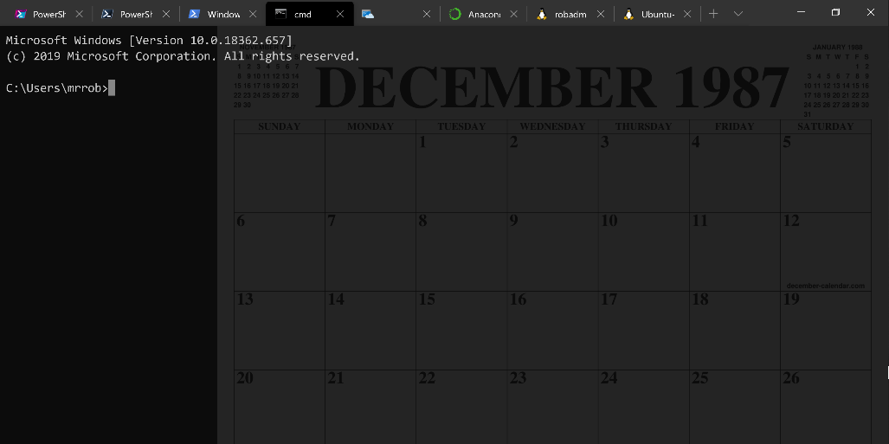
Running Queries

Slide 12
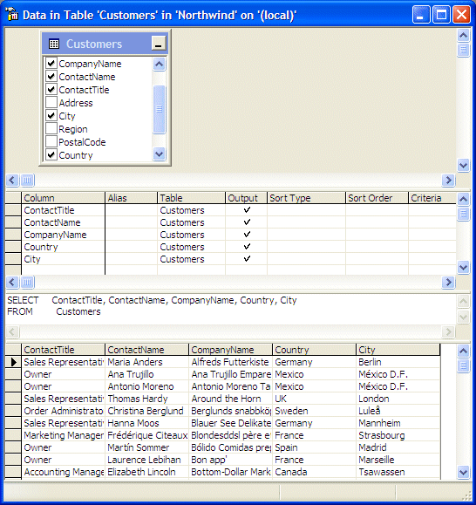
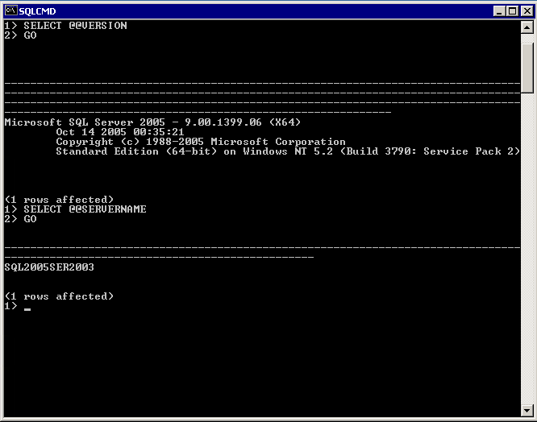

Slide 13
Two and a Half Decades

Slide 14
Uh, Houston, we've had a problem
https://en.wikipedia.org/wiki/Houston,_we_have_a_problem

Slide 15
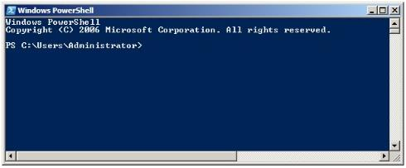
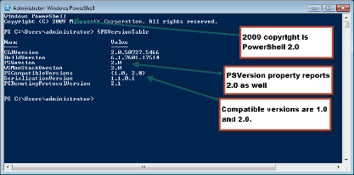
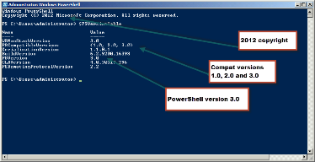
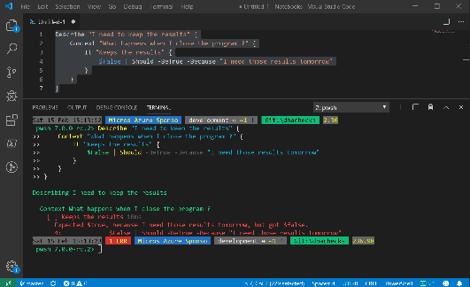
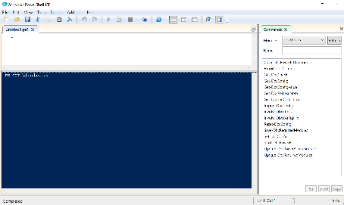
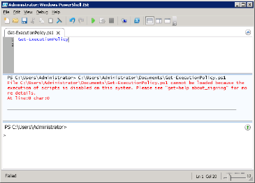
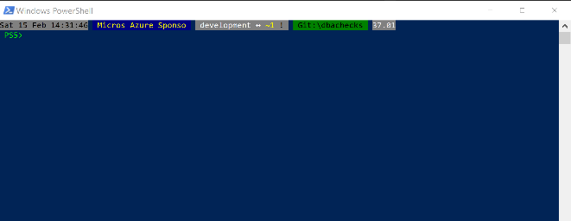
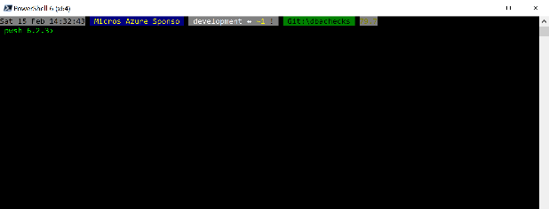
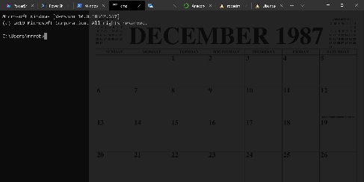
Without some effort………..

Slide 16
Without some effort………..

Slide 17
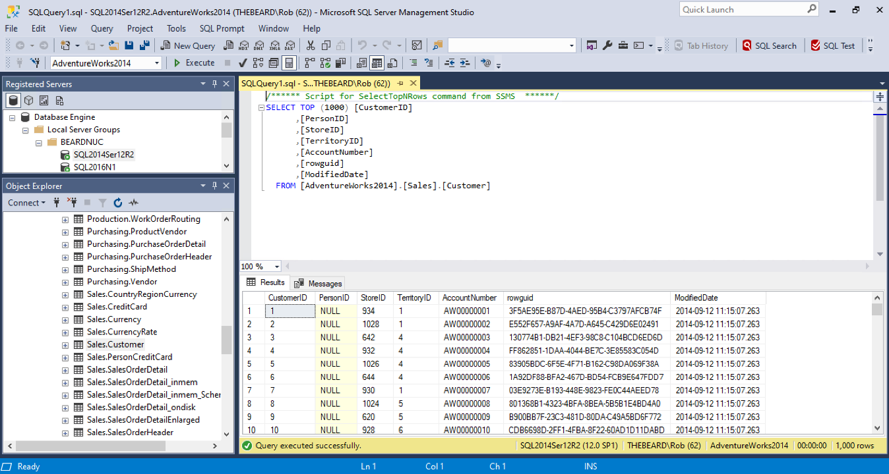

Slide 18
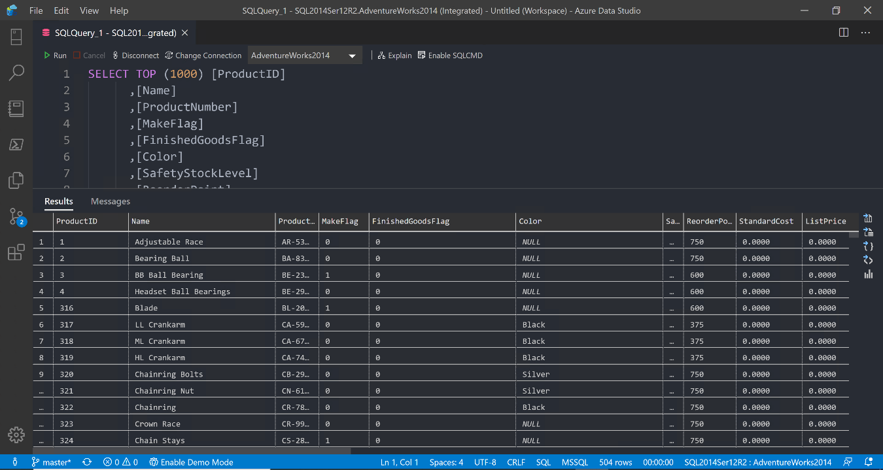

Slide 19
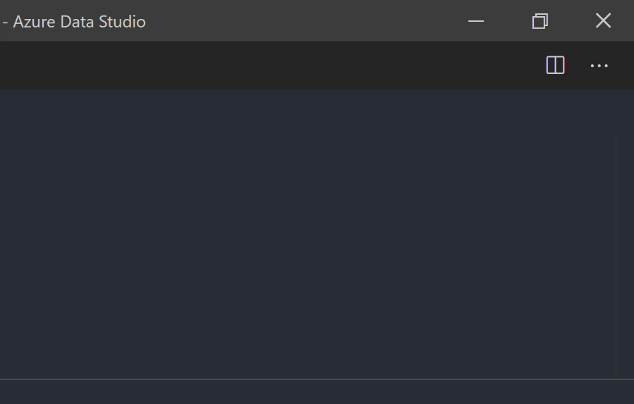

Slide 20


Slide 21
ALL
GONE

Slide 22
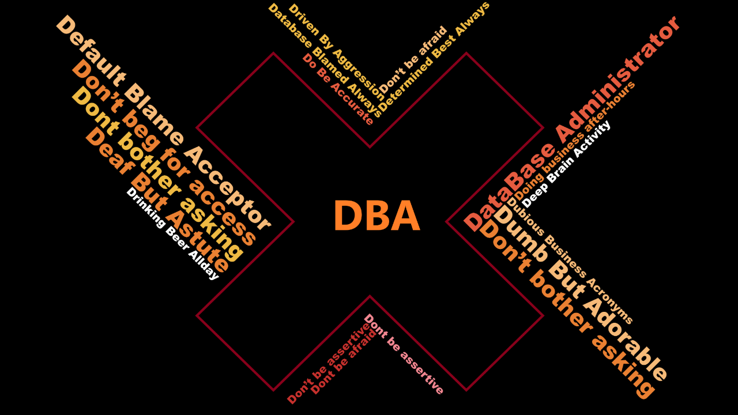

Slide 23
What is a Jupyter Notebook?
Document that can contain text, code, images and query results

Slide 24
What is a Jupyter Notebook?
Document that can contain text, code, images and query results

Slide 25
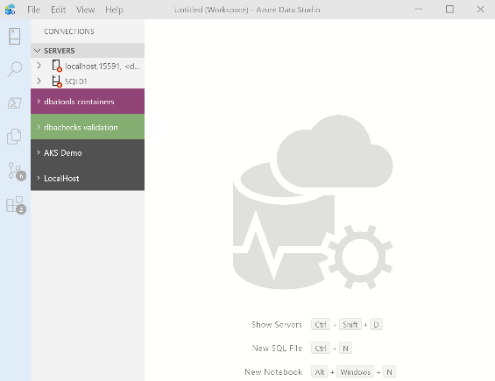
What’s Azure Data Studio ? ?
Cross Platform desktop environment for Data Professionals

Slide 26

So it’s only for Azure ?

Slide 27
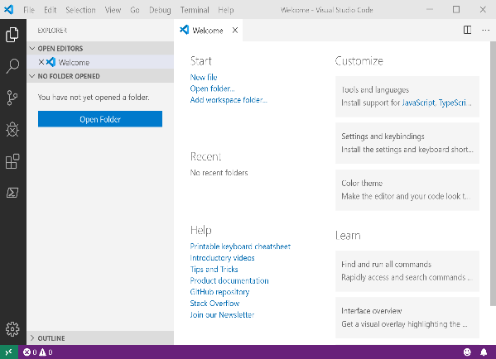
It Looks Like Visual Studio Code ?

Slide 28
It Looks Like Visual Studio Code ?

Slide 29

Time For A DEMO

